Slide 1
MCAPS 2023: Azure Migrations

Slide 2
We’re More Than Your Traditional IT Services Provider
NTT Corporation operates 200+ data centers worldwide
Process 100 million healthcare claims annually
Serve 25 of the leading financial institutions in
North America
Serve 90+ federal agencies and military branches
Serve the top 10 automotive companies worldwide
Apply 45+ years of applications experience
Support 4+ million end users and 11+ million service desk contacts annually
330,000 professionals | $108B
#83 on Fortune Global 500¹
#35 World’s Most Valuable Brands ²
190,000 professionals | $30B
Top 10³ global business & IT services provider
Top 10 Most Valuable IT Services Brands⁴
¹Source: Fortune Global 500 (2022)
²Source: Brand Finance Global 500 (2022)
³Source: Gartner, "Market Share: IT Services, 2021" published on April 8, 2022 – NTT DATA ranked at 6th place
⁴Source: Brand Finance IT Services 25 (2023)
Notes:
NTT DATA Services is a recognized leader in IT and business services including cloud, data and applications. A division of NTT DATA headquartered in Texas, the company leverages consulting and deep industry expertise to help clients accelerate and sustain value throughout their digital journeys.
We’re known for our proven expertise and innovation in industries like healthcare, financial services, insurance, manufacturing and public sector. That, combined with unwavering dedication to your success, is why clients stay with us for years,
A little background on our family tree:
NTT is a partner to more than 75 of the Fortune Global 100. The company is recognized as one of the world’s most valuable global brands, ranking #41 in the Brand Finance Global 500 for 2023. https://brandirectory.com/download-report/brand-finance-global-500-2023-preview.pdf
It is a $108B organization with 330,000+ professionals in 80+ countries and regions and operates 200+ data centers worldwide. NTT is ranked #83 in the Fortune Global 500: https://fortune.com/company/nippon-telegraph-telephone/global500/
NTT DATA is part of the NTT family of companies. It is a top 10 global business and IT services provider with 190,000+ professionals in more than 50 countries (when combined with NTT Ltd.) and revenue of $30B. The company is recognized in the top-10 for the most valuable IT services brands, ranking #6 in the 2023 Brand Finance IT Services 25. https://brandirectory.com/download-report/brand-finance-it-services-25-2023-preview.pdf
NTT DATA Services is part of NTT DATA’s $18B global business outside of Japan.
Together, we collaborate on applied innovations and deliver solutions from the network and data center to the boardroom.
Conversion rate for NTT DATA FY2021 revenue: 1 USD = 112.42 JPY
Conversion rate for NTT FY2021 revenue: 1 USD = 112.39 JPY

Slide 3
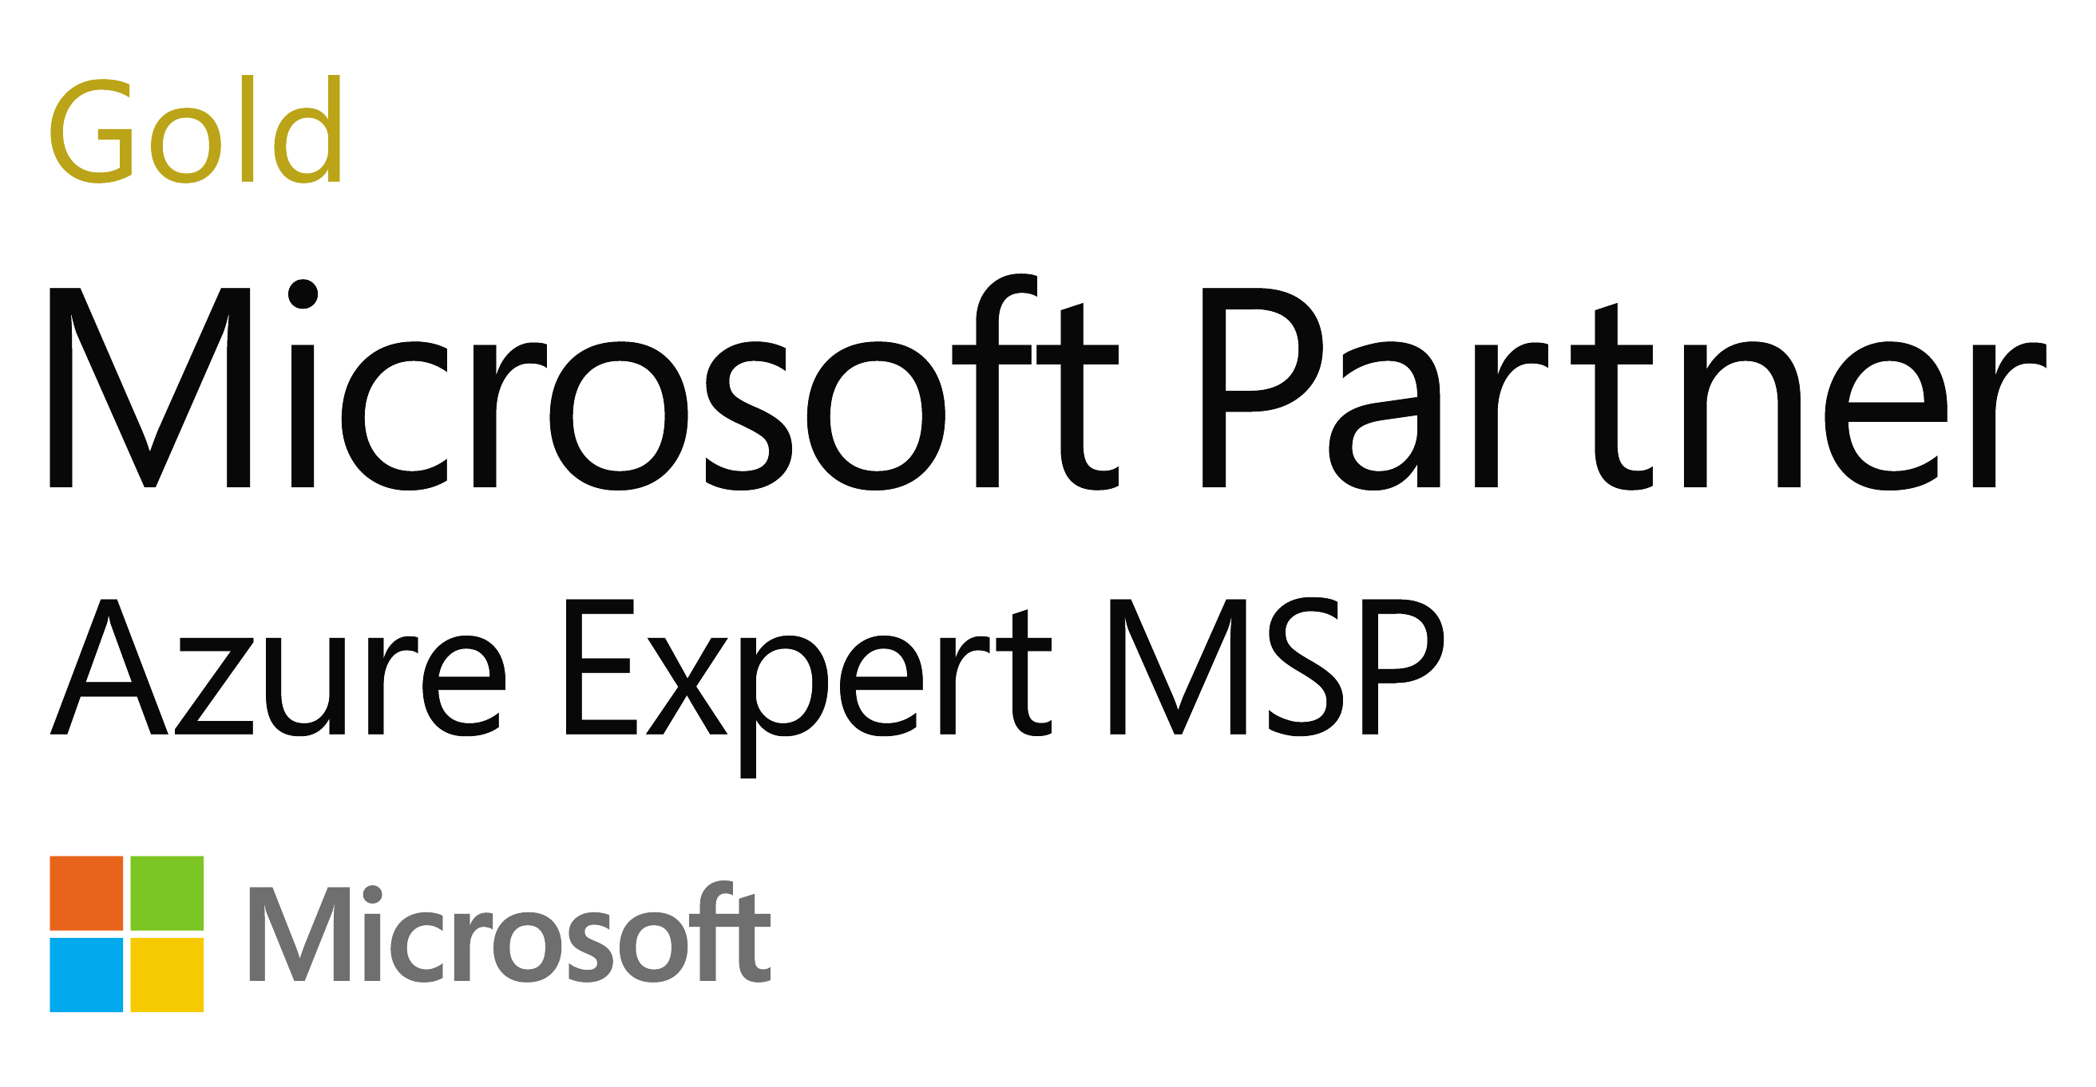
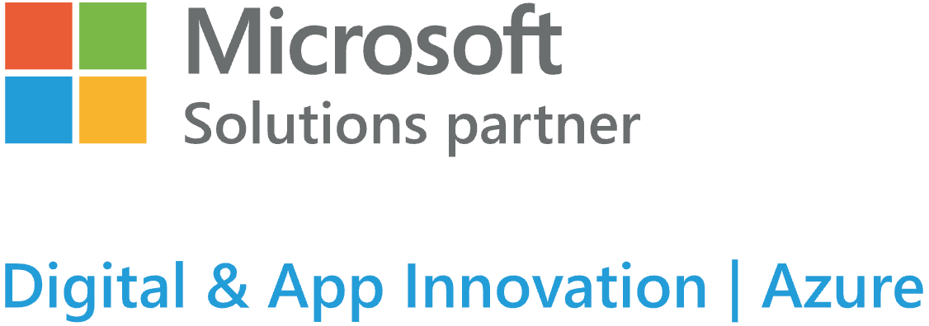
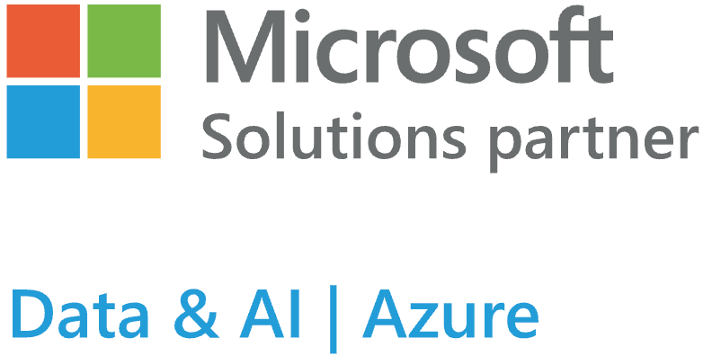

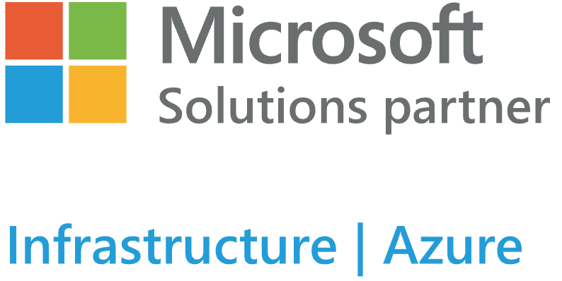
NTT DATA: a trusted cloud transformation partner
NTT DATA Marketplace offers:
Sustainability
Build Cloud Foundations
Mainframe Migration
Enabling Hybrid workforce with virtual workspace
Defender for Endpoint Advisory
CASB (MCAS) Advisory
Managed Microsoft Defender for Cloud
Azure AD Advisory
Data Classification & Protection
Next Gen Windows Advisory
Windows 365 POC
Modern Endpoint
14 Microsoft Gold Competencies
3 Advanced Specializations:
  Identity and Access Management
  SAP on Azure
  Windows and SQL migration to Azure
Azure Government Cloud CSP Partner
4,000+ Specialized Microsoft Consultants
3,000+ Azure Certifications
420 managed cloud clients
12,000+ agile practitioners
1,000+ DevOps (CI/CD) engineers
1,000 consultants supporting cloud brokerage and orchestration
A Leader in the Cloud Infrastructure Management Services NEAT Report
NelsonHall, July 2022
A Leader in the SAP Cloud Migration Services NEAT Report
NelsonHall, February 2021
A Major Player in the Worldwide Cloud Professional Services MarketScape Vendor Assessment
IDC, April 2022 (Doc # US48061322)

Slide 4
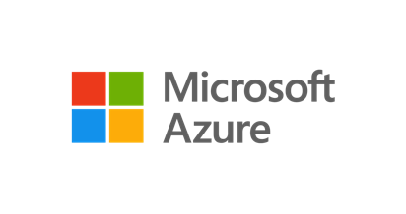


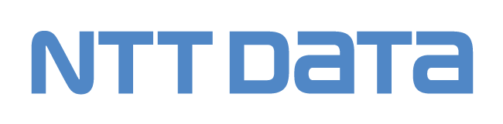
Our Unified Cloud Adoption Framework Aligns to Major Hyperscale Adoption Models
Microsoft Cloud Adoption Framework for Azure
AWS Well-Architected Framework
Google Cloud Adoption Framework
NTT DATA’s Unified Cloud Adoption Framework
Define
Motivation
Outcomes
Advisory
Discover
Justifications
Vision
Cloud maturity
Digital estate
Skillset
App delivery
Plan
Desired outcomes
Address gaps
Transformation roadmap
Design
Ready
Align organization
Transform skills
Create landing zones
Automation
Adopt
Migrate apps
Migrate data
Migrate databases
Modernize apps
Manage
Infrastructure
Application
Data
Toolset
Security
Governance
Continuous Innovation

Slide 5
NTT DATA Offers a Complete Range of Customizable Services
Inspire Cloud Thinking
Cloud Advisory
Planning the cloud journey including business case, cloud strategy and architecture services.
Build Cloud Foundations
Cloud Implementation
Architecting, designing, implementing, and migrating cloud workloads.
Run Cloud Operations
Cloud Management
Supporting foundational cloud operations.
Evolve Cloud Innovation
Continuous Innovation
Managing prioritized backlogs, optimizing workloads and identifying improvements.
Secure Cloud Posture
Cloud Security
Security consulting, implementing and managing cloud workloads.

Slide 6

NTT DATA Azure Accelerators
May 15, 2023
NTT DATA Services
Version: 1.00

Slide 7
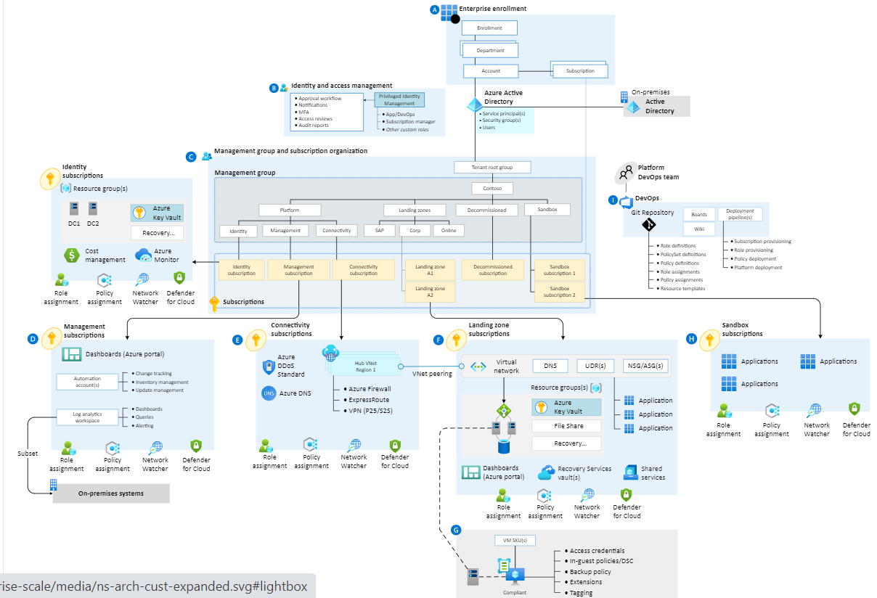
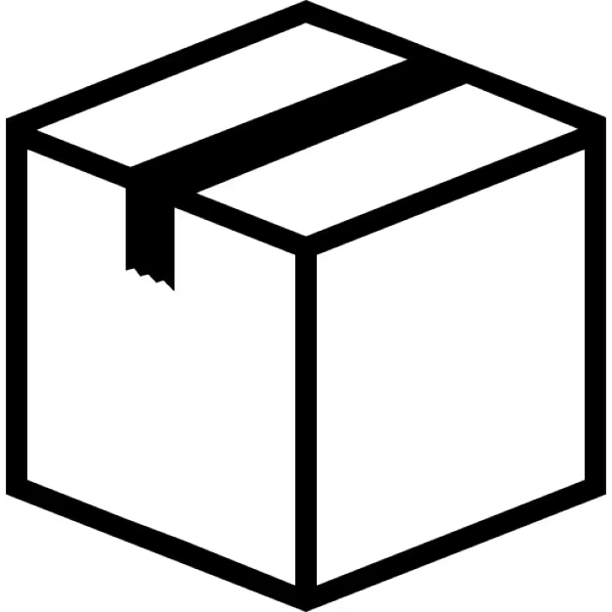

Azure LZ Solution in a Box
What is an Azure LZ Accelerator? It’s Azure ALZ in Box
What are the benefits
Foundation: Is a packaged and tested AZL foundation layer.
Tested: Solution is already designed architected and tested
Time: Reduced deployment time from days to hours.
Cost: Reduced cost through automated deployment
Risk: Eliminates manual errors.
Repeatable: Easy to repeatable as often as needed for test or other regions.
Modify: Easy to modify, modular design.
Secure: Security best practices out of the box.
IaC: Infrastructure as code.
Trained: NTT DATA Trained Deployment Engineers
Deployment time measured in Hrs
ALZ-Accelerator

Slide 8
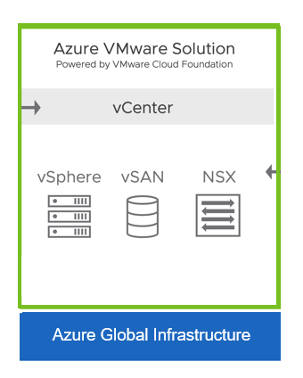
Azure VMware Solution in a Box
What is an Azure VMware Solution Accelerator? It’s Azure VMware Solution (AVS) in Box
What are the benefits
Foundation: Is a packaged and tested AVS foundation layer.
Tested: Solution is already designed architected and tested
Time: Reduced deployment time from days to hours.
Cost: Reduced cost through automated deployment
Risk: Eliminates manual errors.
Repeatable: Easy to repeatable as often as needed for test or other regions.
Modify: Easy to modify, modular design.
Secure: Security best practices out of the box.
IaC: Infrastructure as code.
Trained: NTT DATA Trained Deployment Engineers
Deployment time measured in Hrs
AVS-Accelerator

Slide 9
Landing Zone Foundation MVP

Slide 10




Azure VMware Solution Accelerator (AVS-Accelerator)
A Robust Future Proof Foundation
What is an Azure VMware Solution Landing Zone Accelerator
AVS-LZA is a 100% infrastructure as code deployment of AVS in Azure as a landing Zone.
Proven foundation proven solution for repeatable deployment of AVS in Azure. Designed, architected to meet industry best practices, security, goverananence, scalability, reliability, operational excellence, sustainability, performance efficiency and cost management.
Why invest in an Azure VMware Solution Landing Zone Accelerator
Zero Risk: AVS-LZA is a proven repeatable solution that is repeatable infrastructure as code .
Secure: Secure out of the box
Proven design: Standardized design with proven design, architecture, operations
Day one operations model: The AVS-LZA has one operations model
Benefits of an Azure Landing Zone Accelerator
Do it correct: Strong foundation for reliable, secure, governed workload deploy with operation excellence and management.
Best practices day one: Adhere to architecture and design best practices with well architected framework in the design of the AVS-LZA
Proven design: Standardized design with proven design, architecture, operations
Day one operations model: AVS-LZA has one operations model

Slide 11

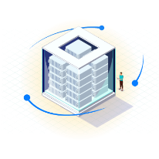
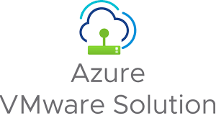

2 Step Cloud Adoption With Azure vMware Services
Step 1
Step 2
Cost reduction
First step to cloud
Elastic resources
Better cost visibility
Set up for modernization
Use skills, tools you have
Keep security model
Reduce AVS footprint
New application and services to cloud native
Modernize legacy and apps that have value
Modernizer at you own pace
Keep running legacy and apps that dose not make sense
Current State
Bridge State
Future State
Current application infrastructure
Unchanged
Current application infrastructure
Modernized for cloud
Modernized Cloud Native application infrastructure
Current vMware infrastructure
Change
Azure vMWare Solution
Azure vMWare Solution
New
Azure Cloud Operating Model
Modernized for cloud
Azure Cloud Operating Model
Current operating model
Unchanged
Current operating model
Azure Cloud Operating Model
(DevOPs, SRE, FinOPs)
Current security model
Unchanged
Current security model
Modernized for cloud
Cloud security model
Current goverananence model
Unchanged
Current goverananence model
Modernized for cloud
Cloud goverananence model
Current tooling, monitoring, logging
Unchanged
Current tooling, monitoring, logging
Modernized for cloud
Cloud tooling, monitoring, logging
Current cost model
Unchanged
Current cost model
Modernized for cloud
Cloud cost model
Current skills
Unchanged
Current skills
Modernized for cloud
Cloud skills
Current org alignment
Unchanged
Current org alignment
Modernized for cloud
Cloud org alignment

