Slide 1
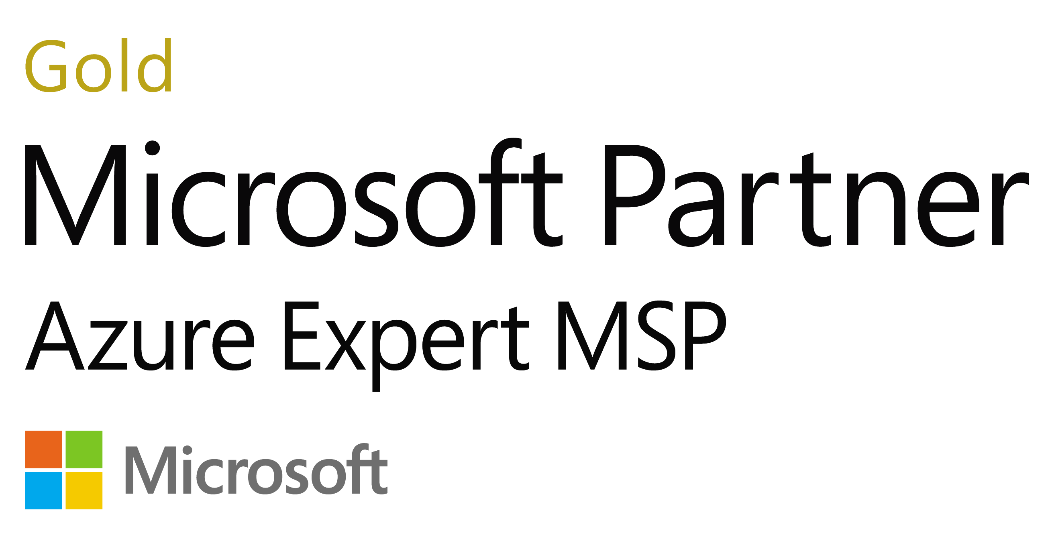
Microsoft Strategic Alliance Partnership
As a 20-year preferred Microsoft partner to hundreds of clients worldwide, NTT DATA’s 100,000+ consultants, global capabilities, and joint solution development with Microsoft provide innovative and high-performance solutions (strategy, implementation, support) for all Microsoft technologies.
Solution Areas
Capabilities
Highlights
Microsoft Services
Client Case Studies
Business Applications
4300+
Specialized Microsoft consultants
Global Strategic Alliance Agreement
Cloud Transformation
2700+
Microsoft certifications
Dynamic Workplace
Data & AI
Global Strategic Collaboration Agreement
14,000
Microsoft/Java app developers
Hybrid Infrastructure
Digital & App Innovation
Microsoft Azure Expert MSP
Security
Partner Programs
Advanced Specializations
Infrastructure
​​​​​​​Cloud Solution Provider - Reseller
Application Development
Identity and Access Management
Azure Marketplace for Apps and Consulting​​​​​​​​​​​​​​
Infra and Database Migration to Microsoft Azure
Microsoft Dynamics
Security
Microsoft AppSource Provider
SAP on Microsoft Azure
Data Architecture Modernization
© 2021 NTT DATA, Inc. All rights reserved.
Notes:
As a 20-year preferred Microsoft partner to hundreds of clients worldwide, NTT DATA’s 100,000+ consultants, global capabilities, and joint solution development with Microsoft provide innovative and high-performance solutions (strategy, implementation, support) for all Microsoft technologies.
About our Microsoft Partnership
NTT DATA is a Microsoft Azure Expert MSP, which is highest level for Azure managed services and requires frequent and rigorous audits to validate our capabilities. This status with Microsoft provides NTT DATA with exclusive access to Microsoft resources and engineering experts and increased access to Microsoft sales teams.
NTT DATA has earned Microsoft Advanced Specializations in:
SAP on Microsoft Azure
Windows Server and SQL Server Migration to Microsoft Azure
NTT DATA built its Nucleus Intelligent Enterprise Platform on Microsoft Azure as the AI and automation engine that helps us create smarter digital solutions.
NTT has a multi-year Global Strategic Alliance Agreement with Microsoft aimed at delivering secure and reliable solutions that help clients accelerate their digital transformations. The alliance brings together NTT’s best-in-class infrastructure, managed services and cybersecurity expertise, with Microsoft’s trusted cloud platform and AI technologies. Key initiatives of the alliance include the creation of a Global Digital Fabric, development of digital enterprise solutions built on Microsoft Azure, and co-innovation of next-generation technologies in the area of all-photonics network and digital twin computing.
NTT DATA has a multi-year Global Strategic Collaboration Agreement with Microsoft that is focused on digitally transforming clients with joint solutions and services built on Microsoft Azure and Microsoft's suite of productivity solutions. To achieve these transformations, NTT DATA and Microsoft will jointly work on capability development and certify 10,000 more NTT DATA consultants on Microsoft technology.
NTT DATA is a Microsoft Azure Expert Managed Services Provider (MSP) – the highest level, which provides exclusive access to Microsoft resources and engineering experts and increased access to Microsoft sales teams
NTT DATA has earned 12 Gold Microsoft Competencies (list below)
NTT DATAS is a Tier-1 Cloud Solutions Provider
NTT DATA has a PowerApps Center of Excellence & Design Patterns
NTT DATA has 14,000+ Microsoft and Java developers and architects
We have 2700+ Microsoft certifications (1000+ are Azure certifications)
We have 4300+ team members specializing in the Microsoft technology stack
Our Microsoft specialties span the digital workplace, Microsoft Azure, security, data intelligence, hybrid infrastructure, application development, Microsoft Dynamics and automation. We can assess gaps in your current systems, choose the best software packages, create solution blueprints, and implement and upgrade your software as needed.
Centers of Excellence guides a seamless end-to-end experience
On-demand consultants and forward planning to scale instantly
Deep knowledge on processes, culture, applications and infrastructure
History of exceeding service levels for hundreds of satisfied clients
Service quality focus through our highly experienced resources
Gold Competencies include:
Application Development
Application Integration
Cloud Platform
Cloud Productivity
Collaboration and Content
Data Analytics
Data Platform
DevOps
Messaging
Project and Portfolio Management
Security
Windows and Devices

Slide 2
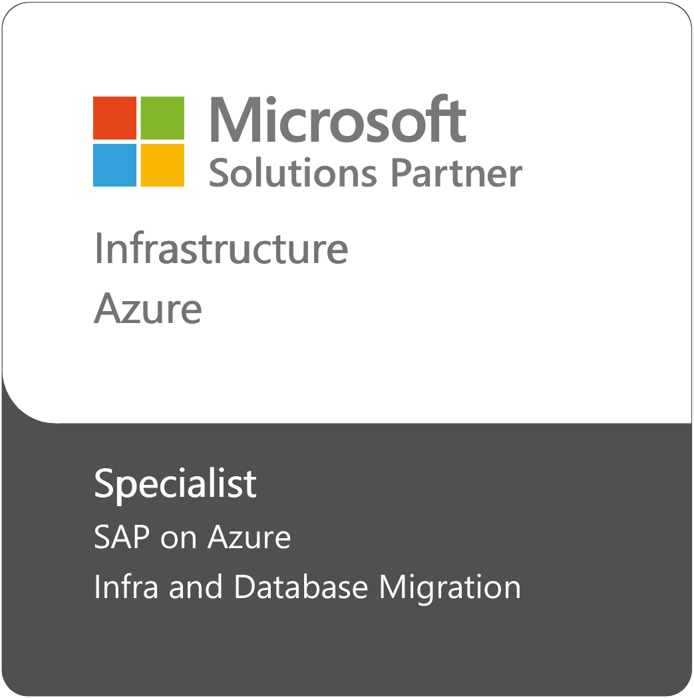
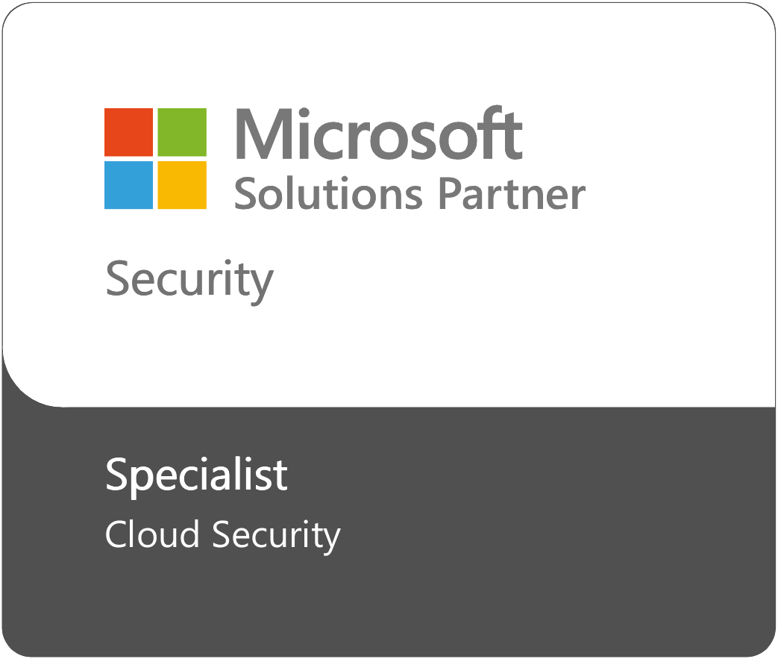
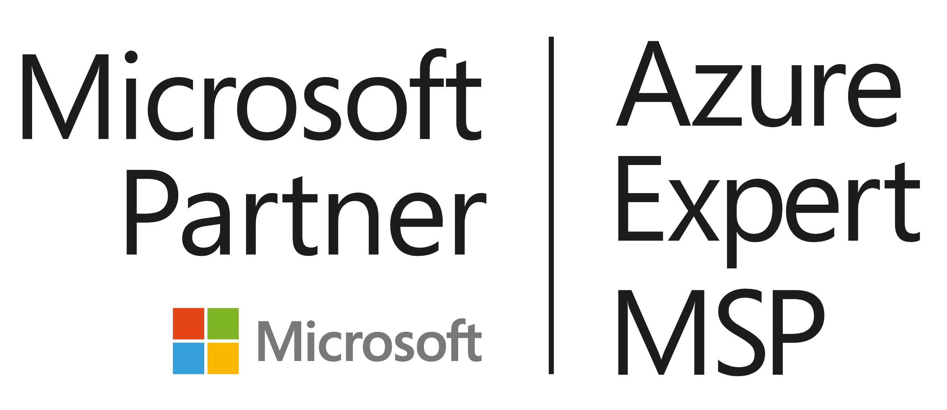
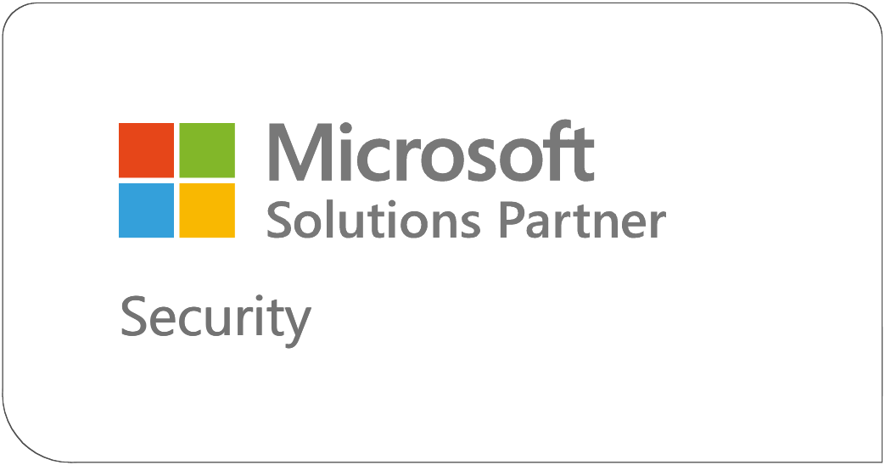
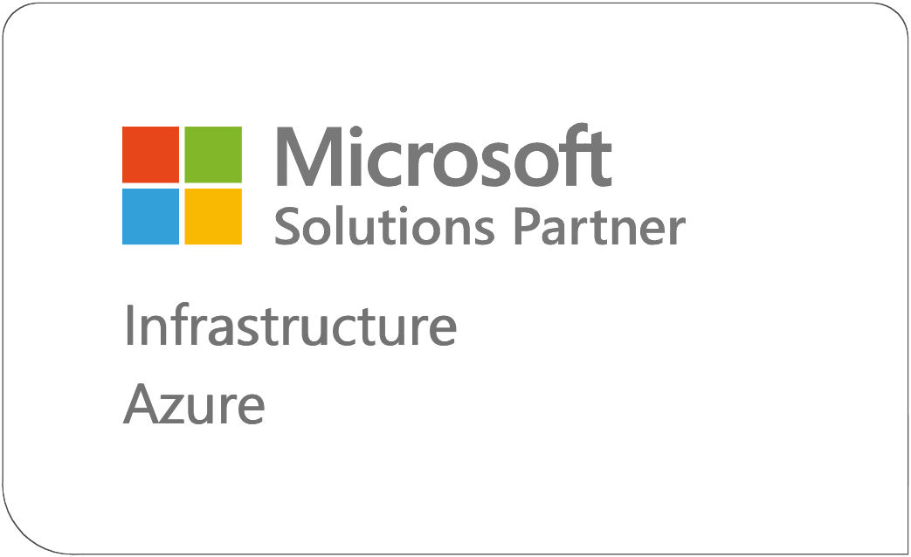
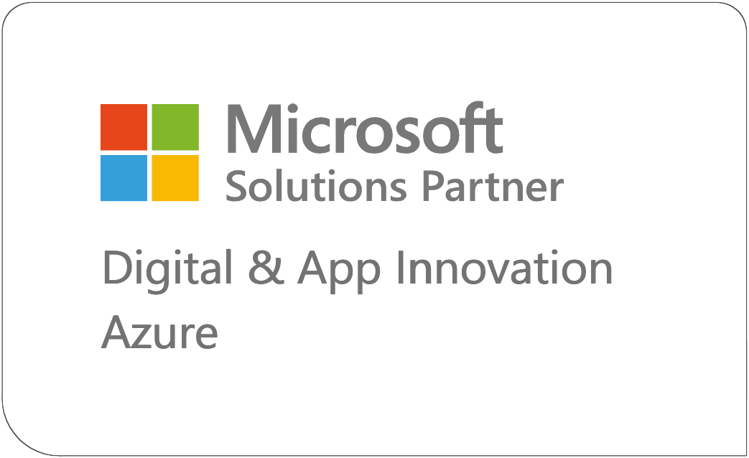
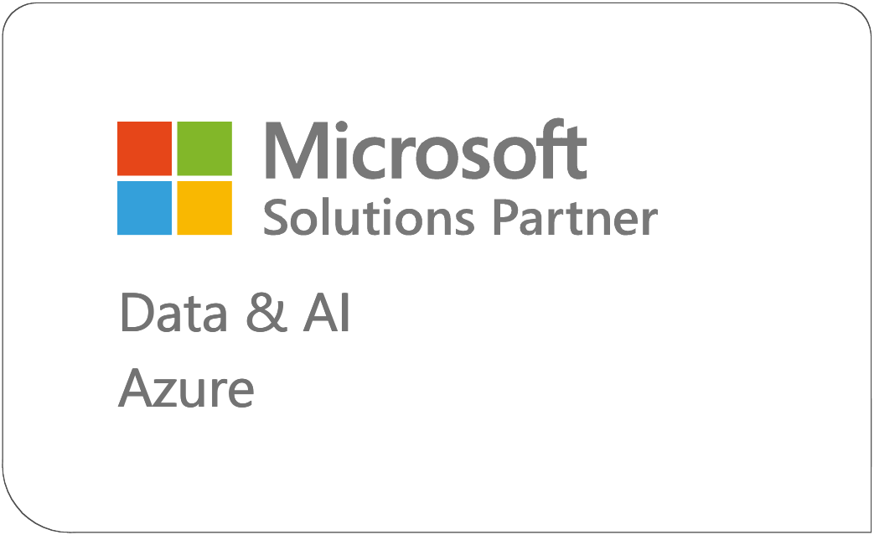
NTT DATA - Trusted and Experienced Cloud Leader
A Top MSP for Azure
A Leader in Low Code Specialist Services
A Major Contender in Azure services
Solutions Review (2022, 2020)
Outsystems, PEAK Matrix Assessment 2023
Everest Group, PEAK Matrix Assessment for Service Integrator capabilities, 2020
Notes:
From an analyst perspective, we are not only a top cloud and msp as you would expect, but more recently we have been recognized in the developer space.
Across our cloud partners we have the credentials to help make you successful with nearly 10K certifications, 16K cloud practitioners and over 400 managed cloud clients
We also have deep experience in agile, devops, clolud brokerage and orchestration

Slide 3
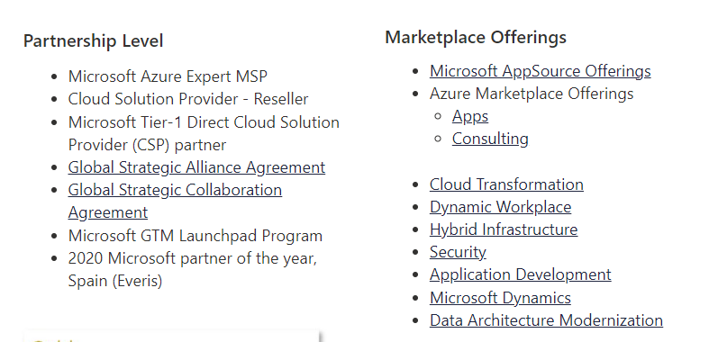
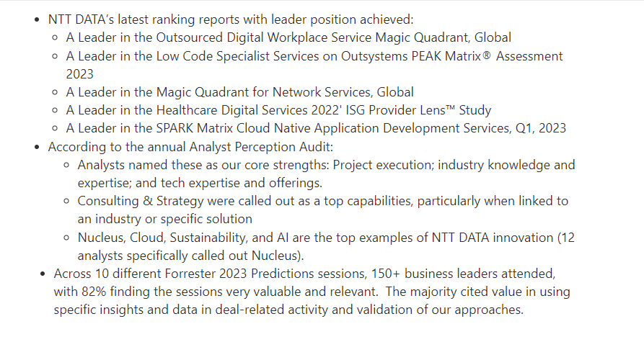
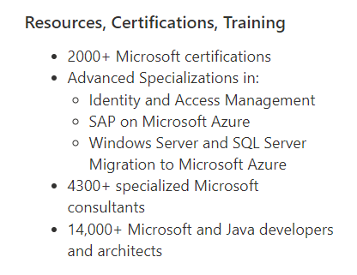
Additional Background
Analysts
12,000+ agile practitioners
1,000+ DevOps (CI/CD) engineers
1,000+ consultants supporting cloud brokerage and orchestration

