Slide 1
NTT DATA’s Digital Trusted Identity Services (DTIS)
Azure Active Directory – Cloud, On-Premise and Hybrid
Stan Riemer (Security Portfolio Specialist)
Ramesh Gupta (Portfolio Leader – IAM)
June 2023
Notes:
Introduction – Brandon.
Actions (Ramesh) – create a slide with pictures – 1. Brandon (NTTD) 2. Ramesh (NTTD) 3. David (MSFT) 4. Steve (MSFT)

Slide 2


330,000+
Professionals
$108B
in annual revenue
80+
Countries
& Regions
#83
Fortune
Global 500
Investing
$3.6B
in R&D
Serves
+75%
Fortune
Global 100
Title Sponsor
Since 2019
Global Strength of NTT Companies
NTT is one of the largest global technology and business solutions companies, with 150+ year heritage of innovation. Ranked one of the world’s most valuable brands, it is the
holding company for all NTT businesses worldwide, including NTT DATA.
Notes:
As part of NTT, NTT DATA Services has the unique benefit to provide the attention you’d expect from a boutique firm with the scale and delivery of a top 10 IT services provider and one of the world’s largest data center operators. In addition, we leverage NTT’s $3.6B investment in R&D (annual average spend for 5 years from 2019) and approx. 5,000 researchers (All group companies in Japan＋NTT Research Inc ).
The NTT Group is a world leader in providing technology and business solutions to people, clients and communities. With $108B in revenue and more than 330,000 employees in over 80 countries and regions, providing services in over 190 of them, we are committed to being a long-term trusted partner and always contributing to society through our business operations.
NTT stats:
Ranked #41 Brand Finance Global 500 https://brandirectory.com/download-report/brand-finance-global-500-2023-preview.pdf
Ranked #83 Fortune Global 500 https://fortune.com/company/nippon-telegraph-telephone/global500/
#2 data center in TeleGeography 2021
Number of sites NTT No. 2 (Equinix No.2）​
Floor space No.2 in the world (Equinix No.1）
Top 5 Global IT Services Provider FY2021 (this represents NTT calculated average based on NTT Group OpCo revenue rankings in Gartner Market Analysis, IT Services:
Total of NTT DATA（22.493B） + NTT Ltd (7.843B) + NTT Com (3.040 B)＝ ＄33.376 B （#5)
Top 5 Global IP Backbone by CAIDA’s ASRank (as of May 2022)
This is the 10th consecutive year that NTT Group has received this award, since the former Thomson Reuters Top 100 Global Innovators. https://group.ntt/en/topics/2021/03/22/clarivate2021/index.html
We operate in 80+ countries and regions across the Americas, EMEA, APAC
18000+ Patents:
Number of patents：18,100
IEEE Fellows (45)
Awarded IEEE milestone (4)
Technical Papers (2.1K+)
150+ years heritage (since the start of telegram service in Japan in 1870)
S&P rating: A (as of September 22, 2021)
333,850 employees (as of March 31, 2022)
952 consolidated subsidiaries (as of March 31, 2022)
Conversion rate for NTT FY2021 revenue: 1 USD = 112.39 JPY
More information about NTT Innovation: https://www.global.ntt/our-innovation.html

Slide 3

190,000+
Professionals
$30B
in annual revenue
50+
Countries & regions
Top 10
Most valuable IT
services brands
Trusted Global Innovator
NTT DATA is a top 10 global business and IT services provider with business operations in more than 50 countries and regions. The parent of NTT DATA Services, the business was established in 1967 as the IT services arm of NTT and became a public company in 1995.
Notes:
NTT DATA is a top 10 global business and IT services provider with business operations in more than 50 countries. The parent of NTT DATA Services, the business was established in 1967 as the IT services arm of NTT and became a public company in 1995. NTT DATA ranks in the top 10 (#6) of the most valuable IT Services brands in the Brand Finance IT Services 25. https://brandirectory.com/download-report/brand-finance-it-services-25-2023-preview.pdf
$30B in annual revenue
190,000 professionals located in 50+ countries and regions worldwide (when combined with NTT Ltd.)
NTT DATA’s core values guide us everyday in the work we do:
Take a client-first approach to ensure their success
Use foresight to identity industry challenges and expand our IT and business expertise
Maintain a commitment to collaboration and teamwork – both within our organization, our sister companies and most importantly, with our clients.
Conversion rate for FY2021 revenue: 1 USD = 112.42 JPY

Slide 4


Business and IT Solutions With Deep Vertical & Domain Expertise
Digital Experiences
Workforce Transformation
Business Resilience
Data-Driven Enterprise
Client Priorities
Industry, Technology & Business Consulting
Financial
Services
Insurance
Manufacturing & Automotive
Health
Plan
Health
Provider
Life
Sciences
Commercial
Public
Sector
Digital Transformation
Digital Operations
Enterprise Applications
Application Development & Modernization
Application Management
Digital Workplace Services
Data & Intelligence
Cloud Transformation
Hybrid Infrastructure Managed Services
BPO & BPaaS
Network & Cybersecurity
Nucleus Intelligent Enterprise Platform
Notes:
At NTT DATA, we deliver industry-centric business and IT solutions to solve your toughest business challenges and to deliver the outcomes that matter most to you.
Learn more about the NTT DATA Nucleus Intelligent Enterprise Platform that powers our offerings: https://us.nttdata.com/en/services/nucleus-intelligent-enterprise-platform

Slide 5
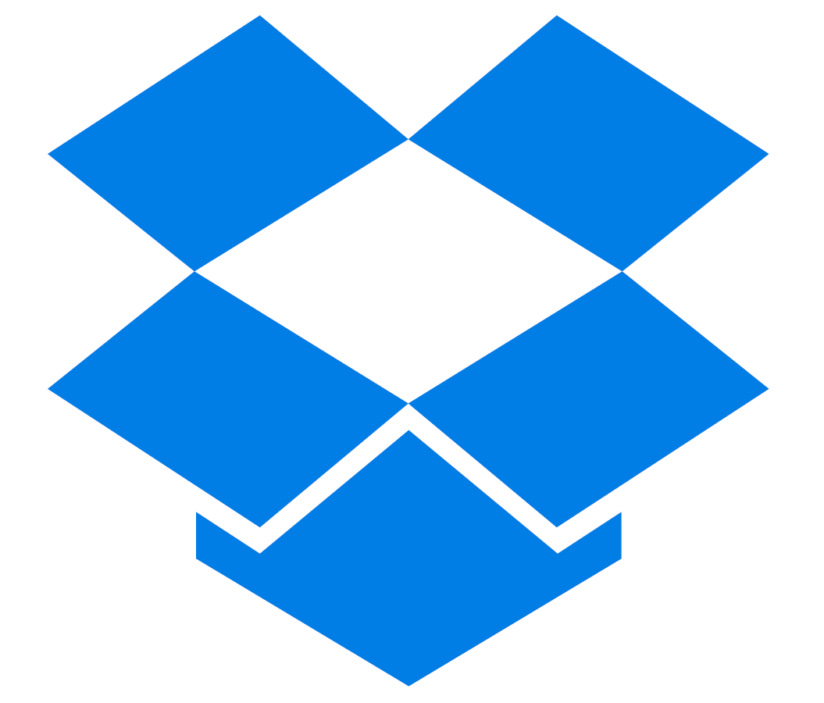






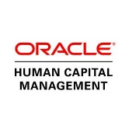


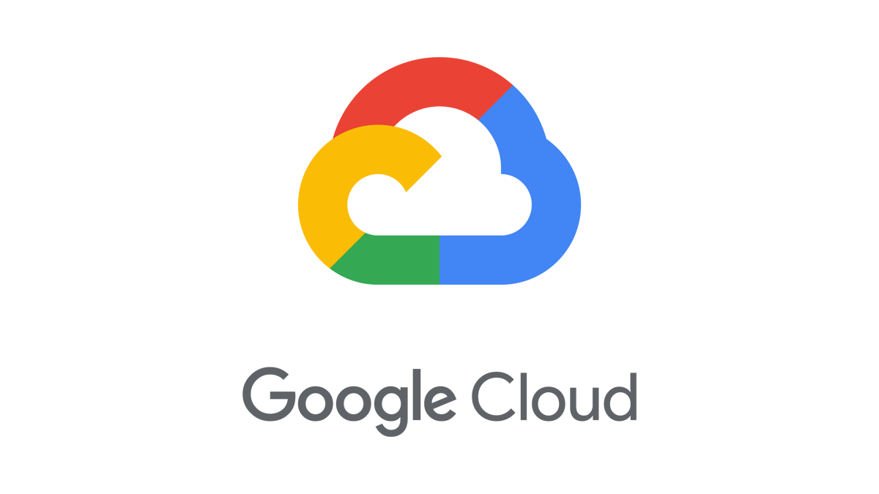

Secure your Identities with Azure AD
SaaS apps
HR apps
Cloud-hosted
apps
Azure AD
On-premises and web apps
On-premises Active Directory

Slide 6




End-to-End Azure AD Capability: Empowering Clients with Technology Solutions
Phase 1
Plan / Advise
Phase 2
Build / Implement
Phase 3
Run / Manage
Organizational Readiness Assessment
Feature set recommendation
Defined Identity Policies
Output: Design Guide
Communications and Implementation Plan
Roll out feature set and automation
Integrate into existing tools
Pilot program and full roll out
Output: Implementation plan
Develop and track success factors
Operationalization
Optimization
Audit Support
Output: Automation scripts and SOPs
We realize that culture change - combined with implementing new technology - is one of the most difficult challenges leadership faces. We understand that It requires a deep commitment to personal, organizational, and technological change and a significant investment of both time and resources. We work with our clients to:
Reinforcement
Ongoing training, improvements and updates software help our clients adopt the newest DTI strategies
Awareness
Demonstrates the need for a change to a simpler system
Establish a clear, strategic vision
Ability
Model changes at the highest levels
Empowers clients to master all of the benefits with a new access management system
DTIS
Teach the new behaviors / offer opportunities for practice
Knowledge
Desire
Learn and understand the new technology and all benefits
Our technology creates the desire to transition to a new system
Commit to the long term
Notes:
Brandon
Let’s talk about – how NTT Data services can help a customer to solve its IAM related business problem using Azure AD as a tool. As with another product, we have three kind of services here – 1. Advisory Services 2. Implementation Services and 3. Managed Services. We will talk in more details about these services in following slides.

Slide 7
Plan - NTT DATA Azure Active Directory (AAD) Advisory Engagement Overview
Identity and Access Management Review
Intro to Azure Active Directory
User Identity Provisioning
Deploy and Manage Devices
  Deliver an Identity workshop to identify elements of the existing Identity and Access Management (IAM) architecture.
  Discuss business concerns and requirements around identity
  Output – IAM evaluation report and top line objectives, concerns and requirements
  Review features and functionality of Azure Active Directory and how these can be used to securely manage identities and assets
  Discuss how Azure AD capabilities can address your concerns and specific goals to accomplish
  Output - prioritized list of objectives
  Review current user provisioning process
  Discuss options for provisioning and authenticating user identities in Azure AD, including Azure AD Connect, ADFS, AD DS, etc..
  Output - defined recommendations for managing identity provisioning and authentication options
  Identify options and benefits of different device join scenarios, such as Azure AD Join and Hybrid Azure AD Join
  Discuss Enterprise State Roaming and possible deployment options
  Output - defined policies that meet your device management and data roaming requirements
Driving Application Adoption
Engage with External Users
Securing Identities
Design Guide
  Compare methods for delivering applications to end users via Azure AD.
  Discuss Single Sign On (SSO) and provisioning users into 3rd party apps
  Review use of Azure AD authentication in building applications
  Output – identify key LOB apps that can leverage AAD SSO and implementation strategy
  Determine use cases for external partners and customers requiring access to internal resources
  Design options for B2B and B2C scenarios
  Output - defined policies that meet customer data security and identity lifecycle manageability objectives
  Discuss use of self-service password reset, Multifactor authentication, Conditional Access, Privileged Identity Management and Managed Identities in Azure AD to ensure security of user and admin accounts
  Output - agree on set of technical controls to design and implement for identity protection
Summarize all gathered intel & established parameters, configuration details and data.
Output - a design guide, architectural diagram and an implementation plan combining your requirements and NTT best-practices
Notes:
Ramesh & David
Message:
NTT Data has worked very closely with Microsoft to come up with Advisory Services workshops
2. How Microsoft is helping other customers and partners to come up with best advisory services - was input to our workshops.
Azure AD Advisory Services is approx two weeks of engagement where our consultants work with customers very closely to understand their business problem, educate them Azure AD features, help them understand how Azure AD can solve their business problem and come up with a solution. For designing these workshops, we worked very closely with Microsoft Team.
This engagement ends up with a Design Guide which becomes input to the next phase of the service which is Implementation.
Identity and Access Management Review box:
https://www.microsoft.com/microsoft-365/partners/microsoft-365-accelerators#security-compliance-identity-workshops
https://sw.transform.microsoft.com/resources → Identity tab → Application Discovery
https://sw.transform.microsoft.com/resources → Identity tab → Microsoft Secure Score Review
Intro to Azure Active Directory box:
https://sw.transform.microsoft.com/resources → Identity tab → Customer Value Conversation.PPTX
User Identity Provisioning box:
https://docs.microsoft.com/en-us/azure/active-directory/ → Cloud Provisioning / Enterprise Users / Hybrid Identity / Domain Services / Authentication
Deploy and Manage Devices box:
https://docs.microsoft.com/en-us/azure/active-directory/ → Device Management
Driving Application Adoption box:
https://docs.microsoft.com/en-us/azure/active-directory/ → Application and HR provisioning / Application Management / Microsoft Identity Platform
https://sw.transform.microsoft.com/resources → Identity tab → Azure AD Application Management
Engage with External Users box:
https://docs.microsoft.com/en-us/azure/active-directory/ → External Identities
Securing Identities box:
https://docs.microsoft.com/en-us/azure/active-directory/ → Identity Governance / Conditional Access / Identity Protection / Managed Identities for Azure Resources / PIM / Reports and monitoring
https://sw.transform.microsoft.com/resources → Identity tab → Self-Service Password Reset / Multifactor Authentication (MFA) / Conditional Access
Design Guide box:
https://sw.transform.microsoft.com/resources → Identity tab → Design Decision Points.xlsx / Key Results, Recommendations and Next Steps

Slide 8
Build - Overview of the NTT DATA Azure Active Directory Implementation Phases
PHASE 1
Build a Foundation of Security
PHASE 2
Import users, enable synchronization and manage devices
PHASE 3
Manage applications
PHASE 4
Audit privileged identities, complete access reviews, manage user lifecycle
Define privileged roles in Azure AD, such as global admin, as well as non-global administrative roles, and enable Privileged Identity Management to track usage of roles.
Configure Self-Service Password Reset for users
Configure password policies, banned passwords and enable on-premises integration for password protection
Configure MFA and Conditional Access baseline
Enable Azure AD Identity Protection to track risky sign-ins and compromised user passwords
Install Azure AD Connect and Azure AD Connect Health
Enable password hash sync and password writeback
Assign licensing to users
Create plan for external user access
Decide on device management strategy
Deploy Windows Hello for Business in organization
Deploy Passwordless authentication methods for users
Identify on-premises, SaaS and other Line of Business applications to see if they can be managed by Azure AD
Integrate supported SaaS applications that exist in the Azure portal
Deploy and configure Azure AD Application Proxy to integrate access to on-premises applications
Enforce the use of Privileged Identity Management
Complete access review for Azure AD directory roles in Privileged Identity Management
Implement dynamic group membership policies
Implement group-based application provisioning for SaaS applications
Automate user provisioning and deprovisioning for HR systems and Azure AD
Enabling Controls
Assess usage and performance patterns from the captured alerts established during the preceding phases to validate the controls meet the objectives. Configure governance controls based on required modifications as indicated during the testing process.
Notes:
Ramesh / Brandon
https://docs.microsoft.com/en-us/azure/active-directory/fundamentals/active-directory-deployment-plans
Depending upon engagement size and complexity, this phase could span from few months to several months. During this phase, the goal is to implement proposed Azure AD solution in customer environment. This is done in a project deliverable model. During this phase, we will be closely interacting with customer’s team to define the requirements (Identities / Apps etc.), implement solution, testing and sign off from the end customers. Each phase could be divided into several sub-phases depending upon business units, business applications etc. The goal here is to have smooth transition from the current system to Azure AD without any business impact. We will also make sure that the environment is fully transitioned to Managed services team (if customer chooses us for Managed Services) or to the customers themselves (or their designated support team) for day to day maintenance.

Slide 9
Run - NTT DATA Azure Active Directory Managed Services
Operational Support
Operational support to ensure Azure Active Directory is operating efficiently. We monitor for threats and provide remediation to help mitigate exposure to risk.
Optimization Support
Continual improvement efforts to consistently
improve the client’s security posture
Audit Support
Support client-let audit preparations for compliance or security program-related efforts
Maintain Azure AD Connect servers and ADFS infrastructure
Regularly execute and triage IdFix reports, ensuring healthy directory synchronizations
Triage Azure AD Connect Health Alerts for Sync and ADFS
Manage user identities, including:
  Group memberships
  Assignment of licenses
  Assign users to enterprise applications
  CRUD (create, read, update, delete) operations
  Manage access by external users
Manage device joins and removal from Azure AD or Hybrid Azure AD.
Configure Conditional Access policies
Monitor authentication logs for anomalies or login problems on:
  Azure AD App Proxy Connectors
  Passthrough Auth Agents
  Password Writeback Service
  On-premises password protection gateway
On a monthly basis:
  Drive improvements to Identity Secure Score
  Manage lifecycle of SSO config for Azure AD
  Triage and investigate security and risk events
  Review and design catalogs and access packages for applications and resources
  Assign users to access packages in line with security policies
  Review approval workflows regularly to ensure the proper approvers are included
  Design and implement Conditional Access policies
On a quarterly basis:
Regularly review to enterprise applications
Regularly review access to directory by external identities
Review who has been granted access to privileged roles
Review steps for defining security gates for activation of privileged roles
Review consent grants to applications
Audit assistance on up to a biannual basis. Such tasks may include:
Review proper application of technical compliance controls in of Azure AD if customer is subject to regulation
Ensure Azure AD audit logs, including sign-in activity and risk events are being archived to a SIEM for historical reference
Export data from Azure AD upon request
Off-band reporting per client-directed requirements
Notes:
Ramesh & Brandon
Operational Guidelines: https://docs.microsoft.com/en-us/azure/active-directory/fundamentals/active-directory-ops-guide-intro
This service kicks in when customer chooses us to provide managed services around Azure AD. We have developed a repeatable process for managing and supporting the environment on a day-to-day basis. Along with Operational Support, we constantly look for optimizing support process in on going manner to make system more efficient. During this service, we also support customers for their Audit needs.

Slide 10
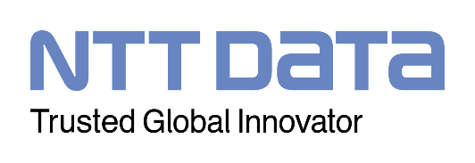
Did you know?
of U.S. enterprises report suffering a breach
data records expected to be compromised by 2023
the average cost of a data breach
to a company
Cybersecurity
71%
146
billion
$3.9
million
Protecting the enterprise against threat actors
SERVICES
OUTCOMES
AWARDS & ALLIANCES
WHY NTT DATA?
Leveraged, dedicated, and hybrid managed models
60 days
saved after
NTT DATA was hired to perform penetration testing
(Konica Minolta Business Solutions)
62% reduction
in security events after two years of managed security
(Fortune 100 financial services firm)
Ranked #2 by revenue in Gartner® Market Share Analysis: Managed Security Services, Worldwide, 2021 (Gartner)¹
Leader in the BFS Risk and Compliance IT Services PEAK Matrix® Assessment 2020 (Everest)²
Major contender in the IT Managed Security Services PEAK Matrix® Assessment 2021 (Everest)
CSA corporate member
Accredited Azure MSP
Top10
In worldwide services, 2021, in market share by revenue (Gartner)⁴
Cloud security
Governance, risk and compliance
Identity and access management
Digital workplace security
Intelligent network security
Managed detection and response
Data security
Application security
Proprietary solutions and research developed from our PHI, CIS and MEI Labs and client collaborations
Improved threat insights by monitoring 40% of global internet traffic and collecting data from 1,200+ “honeypots”
~$2.3 million
saved by providing HER and PACS on a security-compliant cloud
(CarePoint Health)
6.1 trillion
logs analyzed annually, liberating our clients’ hybrid IT experts
(NTT Global Threat Intelligence Platform)
5,000 security experts with certifications from CISSP, CISA, CSM, CCSK, CSF and others
8 security operations centers supported by 7 R&D centers with an annual budget of $4 billion
GARTNER is a registered trademark and service mark of Gartner, Inc. and/or its affiliates in the U.S. and internationally and is used herein with permission. All rights reserved. Gartner does not endorse any vendor, product or service depicted in its research publications and does not advise technology users to select only those vendors with the highest ratings or other designation. Gartner research publications consist of the opinions of Gartner’s Research & Advisory organization and should not be construed as statements of fact. Gartner disclaims all warranties, expressed or implied, with respect to this research, including any warranties of merchantability or fitness for a particular purpose.
Sources:
¹ Gartner® Market Share Analysis: Managed Security Services, Worldwide, 2021 – June 2022
² Everest Group. “IT Managed Security Services (MSS) PEAK Matrix® Assessment 2021,” June 2021
³ Everest Group. “IT Services PEAK Matrix® Assessment 2020: Building Cloud-Based Data Infrastructure for Intelligent Real-Time Controls.” June 2020
⁴ Gartner®, Market Share Analysis: IT Services, Worldwide, 2021 - June2022

Slide 11








Platform Specialists – Cybersecurity FY23
What we do…
Rob Mariani
Global Sales Team Leader
“Front Door” for all Cybersecurity opportunities
  DO and CDTS
    Advisory, Implementation and Managed Services
Aligned by SBU and Integrated with SBU specific selling process
  Account Planning
  Thought Leadership
  Sales Pursuits
  Closing and Winning!
We position our capabilities with clients and prospects, qualify opportunities and manage pursuit activities to win new Cybersecurity Revenue
Platform Specialists - Cybersecurity
Pre-Sales Advisors
Scott Benson
Healthplan Life Sciences
Rich Darrell
Public Sector, Emerging Accounts
Brian Eckert
TBH
Robert Laviolette
Manufacturing
Stan Riemer
International Business/FSI
Contact the team:
securitysales@nttdata.com
Brian Saucier
Paul Brillaud
Commercial Industries
Healthcare Provider, Canada
Harbir Brar
FSI
© 2022 NTT DATA, Inc. All rights reserved.
11

Slide 12
security.sales@nttdata.com
Notes:
Ramesh – Thank you note.

