Slide 1
NTT DATA Security Services –
Threat Protection with XDR and SIEM
June 2023

Slide 2
Corporate Overview

Slide 3

190,000+
Professionals
$30B
in annual revenue
50+
Countries & regions
Top 10
Most valuable IT
services brands
Trusted Global Innovator
NTT DATA is a top 10 global business and IT services provider with business operations in more than 50 countries and regions. The business was established in 1967 as the IT services arm of NTT and became a public company in 1995.
Notes:
NTT DATA is a top 10 global business and IT services provider with business operations in more than 50 countries. The parent of NTT DATA Services, the business was established in 1967 as the IT services arm of NTT and became a public company in 1995. NTT DATA ranks in the top 10 (#6) of the most valuable IT Services brands in the Brand Finance IT Services 25. https://brandirectory.com/download-report/brand-finance-it-services-25-2023-preview.pdf
$30B in annual revenue
190,000 professionals located in 50+ countries and regions worldwide (when combined with NTT Ltd.)
NTT DATA’s core values guide us everyday in the work we do:
Take a client-first approach to ensure their success
Use foresight to identity industry challenges and expand our IT and business expertise
Maintain a commitment to collaboration and teamwork – both within our organization, our sister companies and most importantly, with our clients.
Conversion rate for FY2021 revenue: 1 USD = 112.42 JPY

Slide 4


Business and IT Solutions With Deep Vertical & Domain Expertise
Digital Experiences
Workforce Transformation
Business Resilience
Data-Driven Enterprise
Client Priorities
Industry, Technology & Business Consulting
Financial
Services
Insurance
Manufacturing & Automotive
Health
Plan
Health
Provider
Life
Sciences
Commercial
Public
Sector
Digital Transformation
Digital Operations
Enterprise Applications
Application Development & Modernization
Application Management
Digital Workplace Services
Data & Intelligence
Cloud Transformation
Hybrid Infrastructure Managed Services
BPO & BPaaS
Network & Cybersecurity
Nucleus Intelligent Enterprise Platform
Notes:
At NTT DATA, we deliver industry-centric business and IT solutions to solve your toughest business challenges and to deliver the outcomes that matter most to you.
Learn more about the NTT DATA Nucleus Intelligent Enterprise Platform that powers our offerings: https://us.nttdata.com/en/services/nucleus-intelligent-enterprise-platform

Slide 5















Cybersecurity at NTT DATA
Advisory
Implementation
Managed Services
Services
Identity & Access Management
Governance, Risk & Compliance
Application Security
Data
Security
Zero
Trust
Capabilities
Digital Workplace
Security
Cloud
Security
Intelligent Network Security
Managed Detection & Response
NTT DATA Advantage
End-to-end Coverage
Innovation &
Automation Advantage
Industry Experience & Technology Expertise
Global
Operations
Notes:
At NTT DATA, we deliver industry-centric business and IT solutions to solve your toughest business challenges and to deliver the outcomes that matter most to you.
Learn more about the NTT DATA Nucleus Intelligent Enterprise Platform that powers our offerings: https://us.nttdata.com/en/services/nucleus-intelligent-enterprise-platform

Slide 6
In Today’s World It Takes Five Key Tenets and Expertise to Prevent Attacks
  Analytics using data from traditional and non-traditional sources for internal and external threats
  Analytics for IoT-collected data in infrastructure security services
Analytics
Automation
  Minimizing manual processes while improving incident response consistency
  Integrating different security and non-security products/platforms automating across services
  Use of artificial intelligence to speed up the threat detection process
  Real-time intelligent threat detection to reduce the number of suspicious incidents
Artificial Intelligence
  Security orchestration and correlation of information to improve ROI
  Solutions across all architectures and AI enabled proactive security management
Robust Architecture
Security intelligence
  A security intelligence group backed by an R&D expenditure of $4B
  40% of world's internet traffic flowing through NTT’s Global Information Technology Network

Slide 7
NTT DATA Offerings

Slide 8

NTT DATA Sentinel Advisory Engagement Overview
Zero Trust Assessment
Introduction to Microsoft Sentinel
Data Source Identification
Workbook/Use-Case Selection
  Conduct a zero trust assessment, and review high-level environment architecture and security solutions currently in place
  Discuss business concerns and requirements
  Output - Zero trust evaluation report and top line objectives, concerns and requirements, as well as a strategic roadmap to reach zero trust
  Review Sentinel features and functionality and how these can be used to protect your IT environment
  Discuss how Sentinel capabilities can address your concerns and specific goals to accomplish
  Output - Prioritized list of objectives to address and the Sentinel features that address your requirements
  Identify data sources that will send information to Sentinel
  Prioritize data sources
  Identify solution for non-Azure devices
  Output – Defined approach to identify and on-board data sources for Sentinel
  Review Microsoft-provided Workbooks and Use Cases
  Agree on relevant workbooks and Use Cases and determine priority
  Identify future custom workbooks and Use Cases
  Output - Defined process to implement and test Workbooks and Use Cases within Azure Sentinel
Integration with Other Tools
Security Automation
Threat Hunting
Design Guide
  Review other Microsoft Security tools and plan for integration to realize maximum overall protection
  Review plan to integrate Sentinel into customer or NTT DATA SIEM solution to aggregate and correlate events and to implement single pane of glass for analyst
  Review security automation and customer’s approach to automating security responses
  Identify existing automated response capabilities and prioritize implementation
  Identify custom automation requirements and prioritize
  Output – Configuration and Implementation plan for automation
  Review and identify existing KQL queries, including Microsoft-provided and in NTT GitHub repos
  Create any KQL queries specific to the customer’s environment or industry
  Output - agreed upon test plan to validate KQL queries and submit to GitHub repository
Summarize all gathered intel & established parameters, configuration details and data.
Output – a design guide, architectural diagram, an implementation plan combining your requirements and NTT best-practices, as well as an operations guide, covering procedures, escalation processes, & service parameters

Slide 9

Overview of the NTT DATA Microsoft Sentinel Implementation Phases
If not already active in the customer’s Azure environment, install and configure Microsoft Defender for Cloud.
Built-in Microsoft connectors will be onboarded to provide rich data insights that will be surfaced with the Microsoft Sentinel console
Non-Microsoft data connectors (i.e. AWS via CloudTrail) will be enabled within Microsoft Sentinel.
Associated Defender for Cloud metrics and controls discussed as critical priorities during the advisory workshops will also be enabled.
Installation of one SysLog or CEF Agent on supported Linux virtual machine for event collection and forwarding to Sentinel
Connect up to two subscribed Threat Intelligence feeds supported by Sentinel. Note: Azure Active Directory Global Admin or Application Admin will be required.
Sentinel Baseline Configuration
Validate the controls and meet the objectives by enabling Controls
Assess usage
and performance patterns from the captured alerts established during the preceding phases.
Configure governance controls based
on required modifications as indicated during the testing process.
Enable Defender for Cloud embedded security policies to assess vulnerabilities that create opportunities for threats and threat actors.
Up to five workbooks will be created to surface deeper insights on critical use cases the client wishes to assess at a more granular level, as determined during the advisory workshop engagement.
Import existing Watchlists based on current threats and provide templates for development of additional watchlists
Workbook
and Policy Development
Workflows can include all subscriptions or in-scope resources (at scale), or be scoped to specific environments, subscriptions or workloads.
Develop agreed workflows for in-scope resources.
Work with the client’s technical team to test the workflows to verify the remediation action aligns to the trigger.
Workflow Automation Creation
Enabling
Controls
Assess security patterns from the captured alerts received after Defender for Cloud and Sentinel implementation phases
Adjust automated governance activities and policies as indicated by the alert behaviors and patterns, with the client’s approval
Finalize documentation required for managed services and steady-state support.

Slide 10

NTT DATA Sentinel Managed Services
Operational Support
Optimization Support
Continual improvement efforts to consistently
improve your security posture
Security monitoring to help ensure defense integrity of the onboarded in-scope environment, with analysis and validation support as sent by Sentinel to the SOC team.
Add and remove log sources on request.
Add new use cases to protect customer environment from new threats.
Create new automation workflows upon request o improve efficiency and security of customer environment.
Analyze, investigate, and escalate security events in accordance with customer policies.
Weekly or monthly report outlining operational metrics, security pattern trends and changes, improvements made, with impact or progress assessments.
Threat Hunting in coordination with NTT DATA’s worldwide threat intelligence platform, which threats identified across NTT’s extensive Internet backbone.
On a monthly basis:
  Present top security use cases and remediation improvements for client consideration, to include review of non-reporting devices, and new recommended optional use cases.
  Review of policy and automation workflow effectiveness to validate the client’s requirements are being met
  Validate remediation recommendations, assess impacts and present mitigation approach to the client.
  On a quarterly basis:
Identify 1-3 workflow automation opportunities to improve the security of the environment.
Review of policy and automation workflow effectiveness to validate the client’s requirements are being met
Validate the existing threat detection workbook effectiveness, optimize based on evolved security patterns and threat trends.
Audit Support
Support client-led audit preparations for compliance or security program-related efforts
Audit assistance on up to a biannual basis.
Such entitlements include:
Export data upon request
Detailed data usage reports
Off-band reporting per client-directed requirements

Slide 11

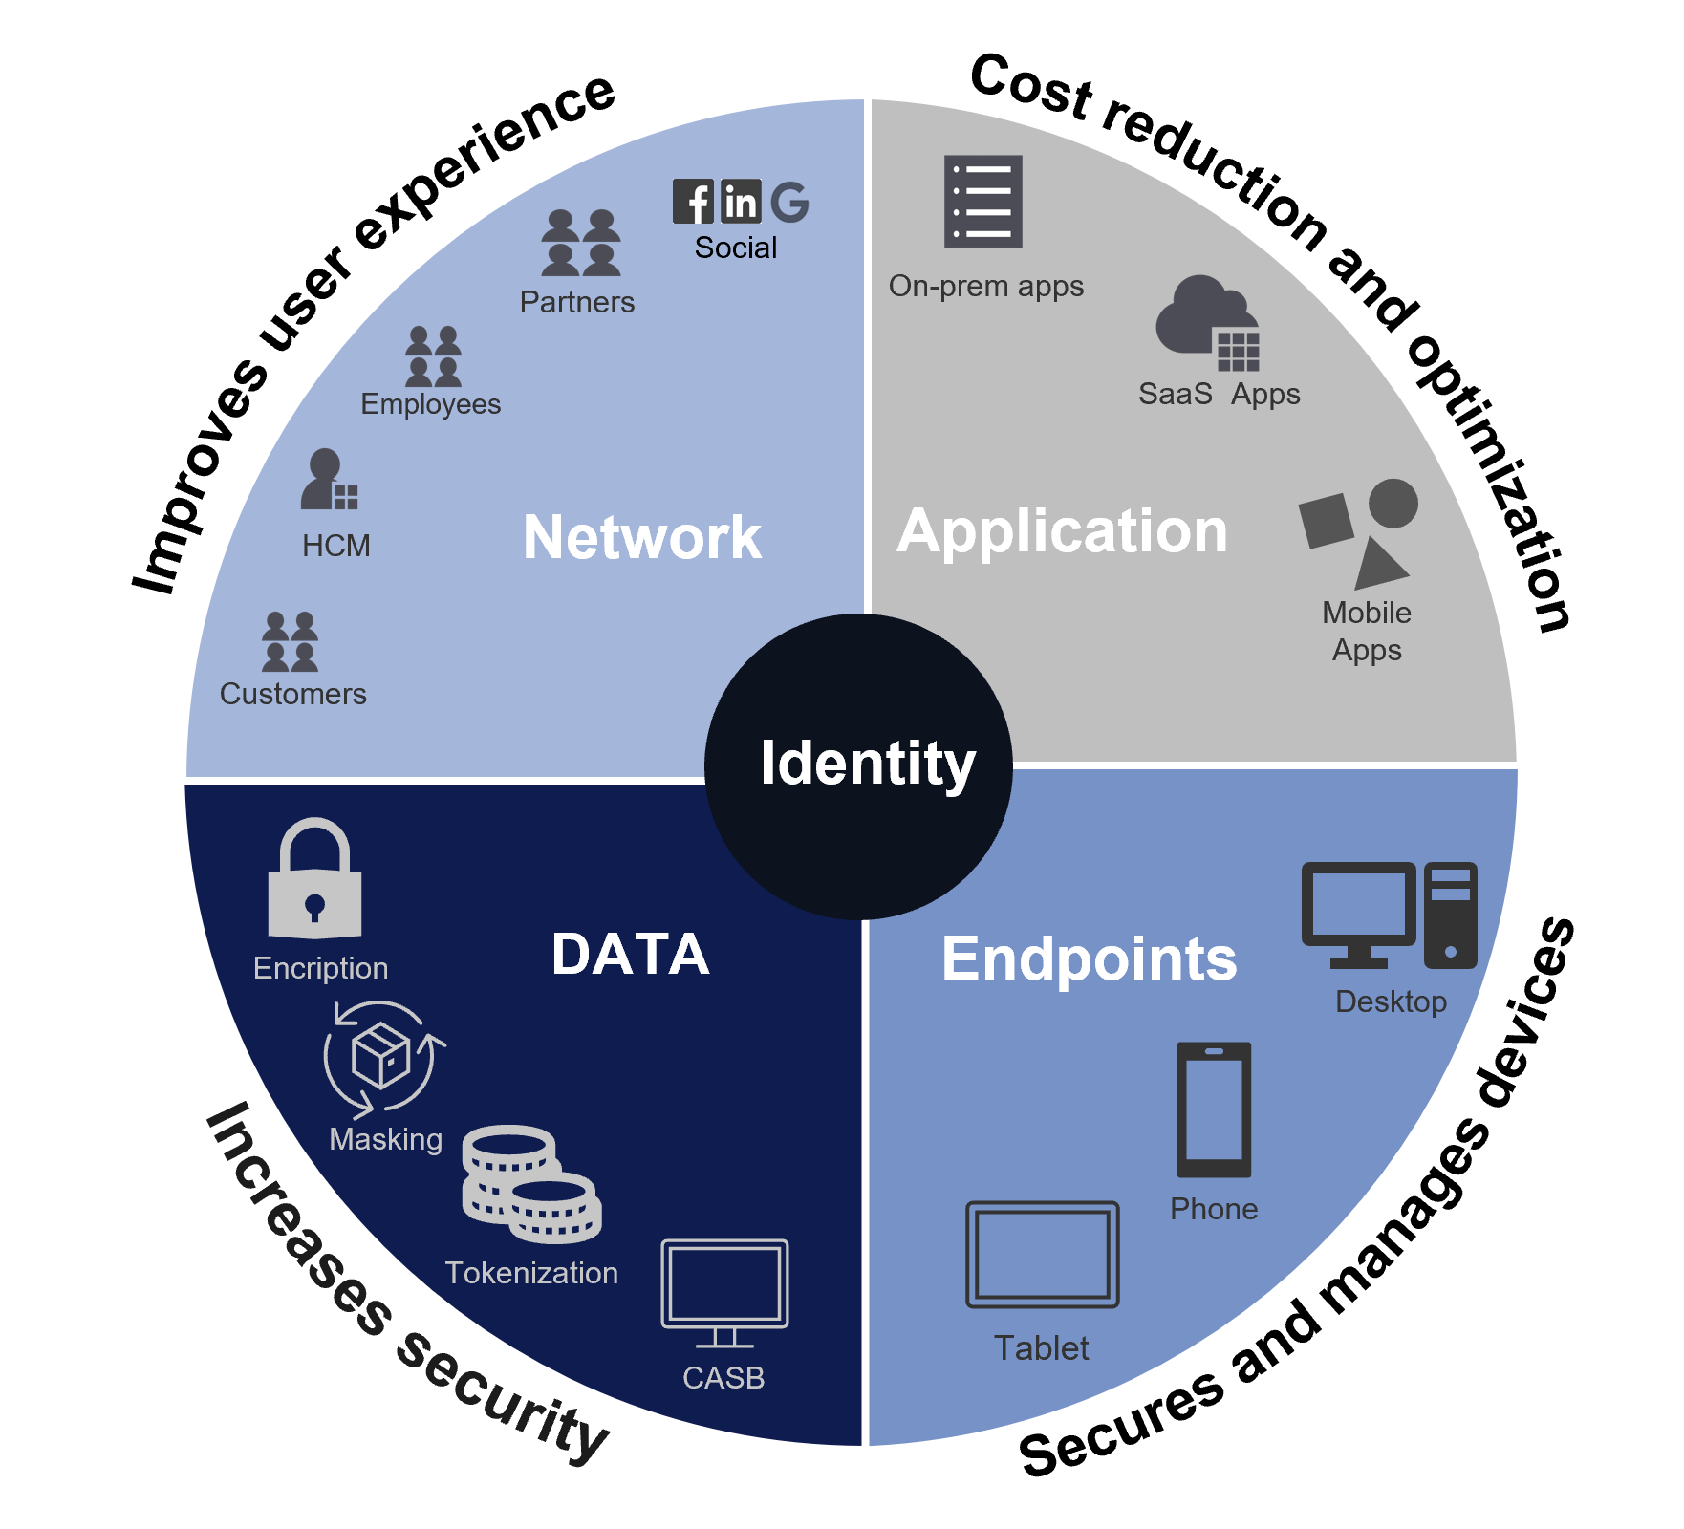

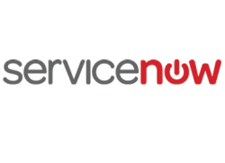





NTT DATA Enterprise Cybersecurity Approach
Next-Gen Security Platform
Zero Trust Security Services
IT/Business
Leadership Services
InfoSec Manager (ISM)
Threat Manager
Delivery Execs
Compliance Management (aaS)
Patch & Vulnerability Management (aaS)
Pen testing as a service (aaS)
IoT
ITSM
XDR/MDR
Correlate
Analyze
Alert
Top tier partnerships
Threat Intelligence
Automatic response
GIAC certified
Data
Security Incident
Tickets, CRs, dispatch, etc.
Global
Award winning
Threat Hunting
5000 cyber SMEs
IoT
Automate and orchestrate — NAC, FW, WAF, DLP, etc
SOP/Best
Practice/
IRP Teams/ Governance
Threat Feeds
UEBA, AI and
ML
NTT DATA Services: The glue that brings Enterprise IT and Enterprise Security together, driving Zero Trust transformation.
Automation, Dashboards
Notes:
We assist clients along their journey providing mature process holistic programs. These structured solutions harden their risk posture to the next levels to compete with the most sophisticated attacks with least amount of business impact.

Slide 12



Log Retention and Threat Hunting
Hot, Warm, and Cold storage retention period is configurable based on customer requirements
KQL queries can be executed for data in hot storage. Data in Hot Storage can be processed through Sentinel as if they are new events to take advantage of new use cases
Azure Data Explorer can be used to review events in warm storage, and data in cod storage can be restored to be usable at an additional cost.
Our threat hunting team has access to NTT DATA’s Global Threat Intelligence Network.
Over 40% of global Internet traffic flows through an NTT
Global client base across industries allows us to create-industry-specific threat information

Slide 13








Platform Specialists – Cybersecurity FY23
What we do…
Rob Mariani
Global Sales Team Leader
“Front Door” for all Cybersecurity opportunities
  DO and CDTS
    Advisory, Implementation and Managed Services
Aligned by SBU and Integrated with SBU specific selling process
  Account Planning
  Thought Leadership
  Sales Pursuits
  Closing and Winning!
We position our capabilities with clients and prospects, qualify opportunities and manage pursuit activities to win new Cybersecurity Revenue
Platform Specialists - Cybersecurity
Pre-Sales Advisors
Scott Benson
Healthplan Life Sciences
Rich Darrell
Public Sector, Emerging Accounts
Brian Eckert
TBH
Robert Laviolette
Manufacturing
Stan Riemer
International Business
Contact the team:
Security.Sales@nttdata.com
Brian Saucier
Paul Brillaud
Commercial Industries
Healthcare Provider, Canada
Harbir Brar
FSI
© 2023 NTT DATA, Inc. All rights reserved.
13

Slide 14
Threat Management

Slide 15


What We Provide as Security Professionals
Mitigate the impact of ransomware for our customers
Make the best use of data feeds and intelligence sources
Update incident response plans and test your capabilities against the most common threat scenarios for your industry and region
Continuously update use cases, playbooks, and SOPs. As threats change, we change with them
Security must be usable to be effective, make recommendations to customers to ensure an appropriate security footprint

Slide 16
We Help Clients Through-out the Entire Security Lifecycle
Protect
Managed security devices
Identity & success management
Secure DevOps
Security architecture and design
Managed end point assessments
Data security
Respond
Incident planning and response
Mitigation
Improvements
Identify
Risk management
Risk assessments
Strategy
Governance
Detect
Security monitoring
Detection processes
Recover
Recovery planning

Slide 17

Threat and Vulnerability Management Services – Security Operations Centre
Security Event Monitoring and Analysis and Response
Active Monitoring
Initial Response
Incident Response
Closure – Escalation - Recovery
Computer Security Incident Response Team (CSIRT)
Vulnerability Scanning and Assessment
Vulnerability Remediation Management
Threat Identification and Advisory Service
SOC Engineering Team
Centralized Security Event Logging
Manage and Configure SIEM
Proactive Device Log Source Management
Add Modify Change SIEM Use Case, Rules, and Tuning

Slide 18
Microsoft Sentinel Features and Capabilities
  Automation
XDR
(eXtended Detection and Response)
SOAR
(Security Orchestration, Automation, and Response for non-Microsoft Tooling)
  Defender for Cloud
  Defender for Endpoint
  Microsoft 365 Defender
  Defender for Office 365
  Other Microsoft Defender Products
  Integration for many common security tools available from Microsoft
  Custom integration can be developed using PowerShell and other scripting languages
  Integration with ITSM tools available to automate ticket creation

Slide 19
Detection and Response Service Delivery Structure
Threat
Management
Advisor
Incident Handling and Closure
Service Management Reporting
Manage New Requirements
Infrastructures
L3: Incident Response/ Engineering
Incident Analysis and Validation
Vulnerability Assessment and Remediation Support
Device Management Tasks
Trend Monitoring and Analysis
Escalation Management
Compliance Reporting
Help Desk System
Performance Management
Problem Management
Change and Release Management
Configuration Management
Service Level Management
Availability Management Continuity Management
Support
Teams
L1 and L2: SOC Analysts
Security Event Monitoring
Incident Detection and 1st Level Analysis
Routine Maintenance and Operational Tasks
Operational Reporting
Business Owners
SOC Operations Managers
Threat
Alert & Advisory
(Intelligent Patch
Management Service)
SOC Management Team
Resource Management, Skill Development
Operational Process Improvement
Program Escalation Management
Customer Management
Knowledgebase/ Security Portal
Perimeter Devices
Endpoints—Desktops and Laptops
SOC Incident Management
Technical Support
Incident Escalation
Product Support
Trainings
Threat Intelligence & Investigation
Innovation
Benchmarks
Reuse Component/ solutions
SOC Engineering
SOC Security
Management of SOC Tool Configuration
Enhancement to SOC Tools
Architecture Design of SOC
Transformation Projects for SOC
Administration of SOC Security
Implementation Projects
Compliance SOC Incident Management
Incident SOC Incident Management
Enhancement Projects
Infrastructure Servers

Slide 20



Event Reporting and Dashboards
Wide variety of available reports and dashboards are available
Custom reports can be created to meet customer-specific requirements
Dashboards can be presented via Azure Security Center
RBAC-based permissions allow customer to select who in their organization can view specific reports and Dashboards

Slide 21
Learning and Adapting to Change
Testing
SOP Updates
Training
Threat Intel Mgmt. and Scoring
Machine
Learning
Tuning
Heuristic Analysis
Automation
Trending
Continuous Updates to Playbooks
Continuous Updates to Use Cases
Response Tracking

